Slide 1
Smart Construction Remote Guide: Installation of SIM card on Android Device Trimble TD540

Slide 2
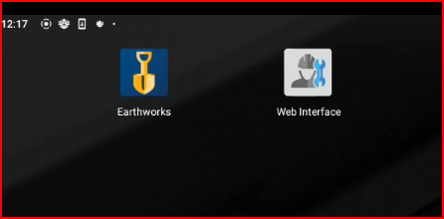
Step 1
Install a SIM card in the device and open WEB INTERFACE app from desktop.

Slide 3
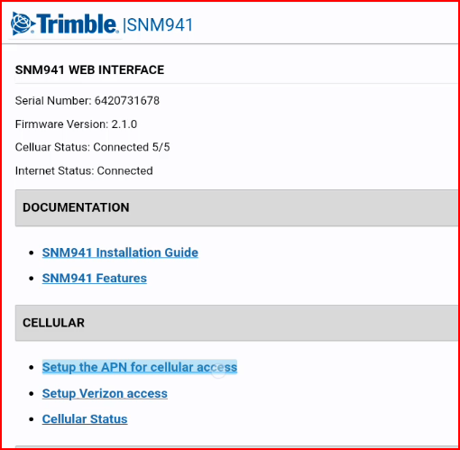
Step 2
Click on “Setup the APN for cellular access” link

Slide 4
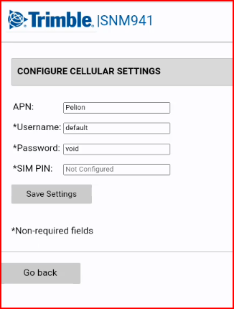
Step 3
Enter necessary information into required fields and select “Go back” button.
Pelion SIM cards:
APN: Pelion
Username: default
Password: void
*Each SIM card provider will have unique APN, username, and password. Please contact your SIM card provider for more information.

Slide 5
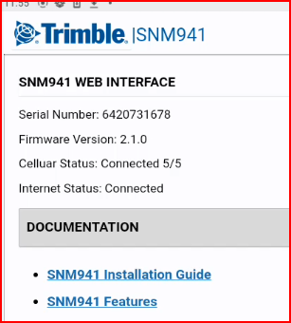
Step 4
Internet status and cellular status will show after several minutes. It may take up to 10 minutes before the connection is established.
*Pelion SIM card is a global sim card which means it is trying to connect to the nearest tower with the strongest signal.

