Slide 1
Smart Construction Remote Guide: Installation on Android Device Trimble TD540
*The following setup requires internet access throughout the entire process*

Slide 2
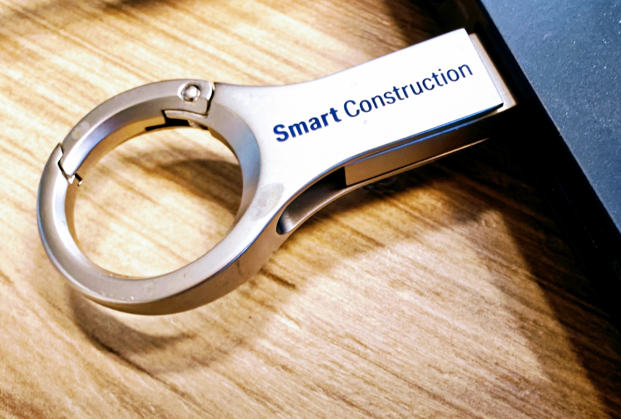
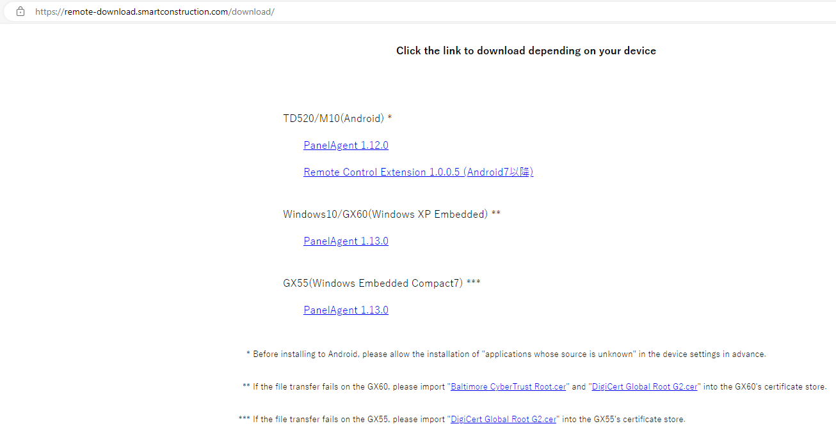
Step 1
Download appropriate Panel Agent from Komatsu download site onto USB:
https://remote-download.smartconstruction.com/download
Download site (smartconstruction.com)

Slide 3
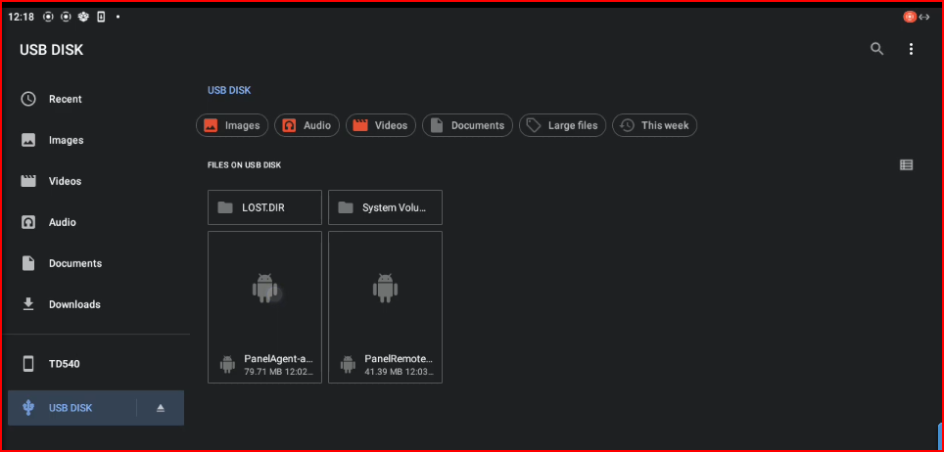
Step 2
Connect USB to TD540 and install “Panel Agent”. Follow the prompts and click “Install” and “Open”.

Slide 4
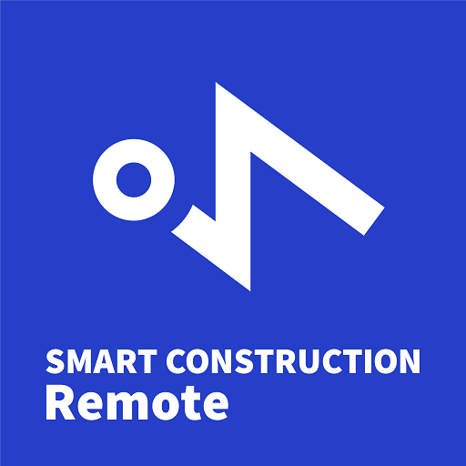
Step 3
Open Smart Construction Remote application. Read and scroll through entire terms of service. To agree and continue, check both boxes and select Consent at the bottom of the screen.

Slide 5
Step 4
Smart Construction Remote requires a MAC address/Device ID to be issued to device. To allow, check “Agree” and select “Next” on the following prompt.

Slide 6
Step 5
Allow access to media and photos on the device.

Slide 7
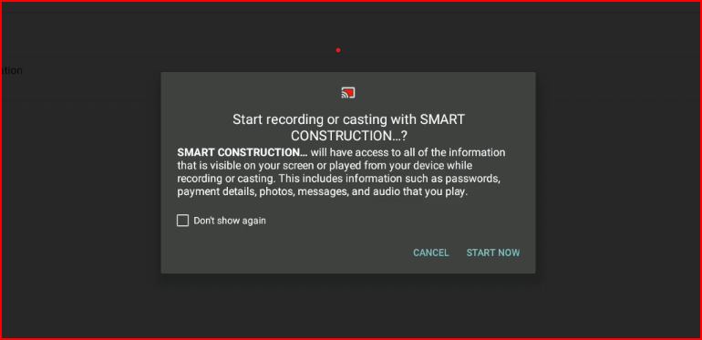
Step 6
Start recording and casting.

Slide 8
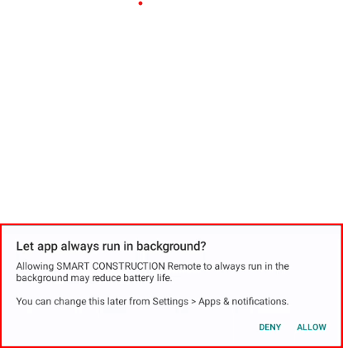
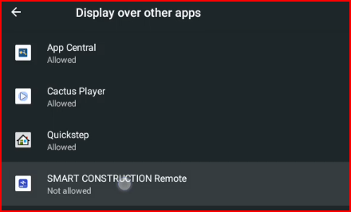
Step 7
“Allow” the app to run in background and grant permissions in the settings menu.

Slide 9
Step 8
When Smart Construction Remote is opened, the following page with a MAC address/Device ID unique to this device will display. This Device ID is needed to register the device on the Smart Construction Remote web application.
*Each time Smart Construction Remote is installed and setup, a new, unique Device ID is issued. If Remote is uninstalled and reinstalled, the Device ID will change and will require the ID to be updated in the web application registration.*

