Slide 1

Smart Construction Remote Guide:
Installation on Topcon FC6400
*The following setup requires internet access throughout the entire process*

Slide 2
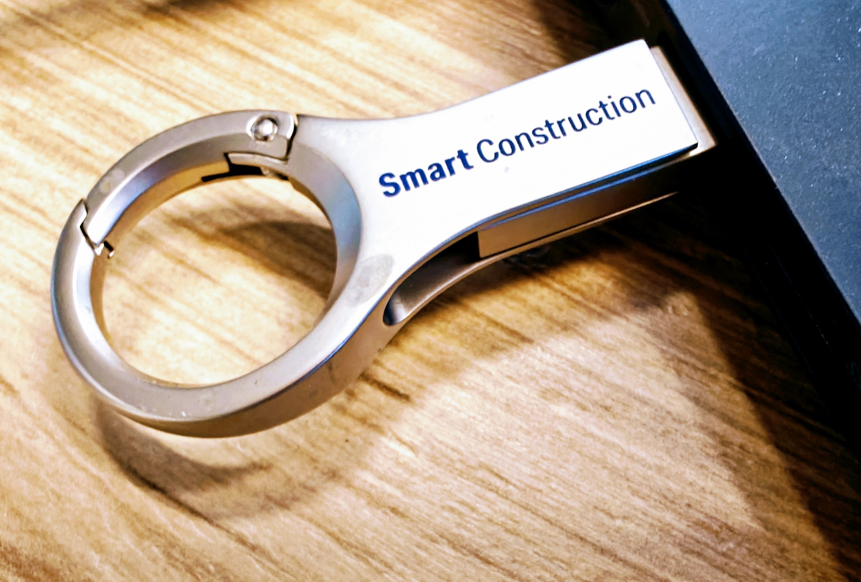
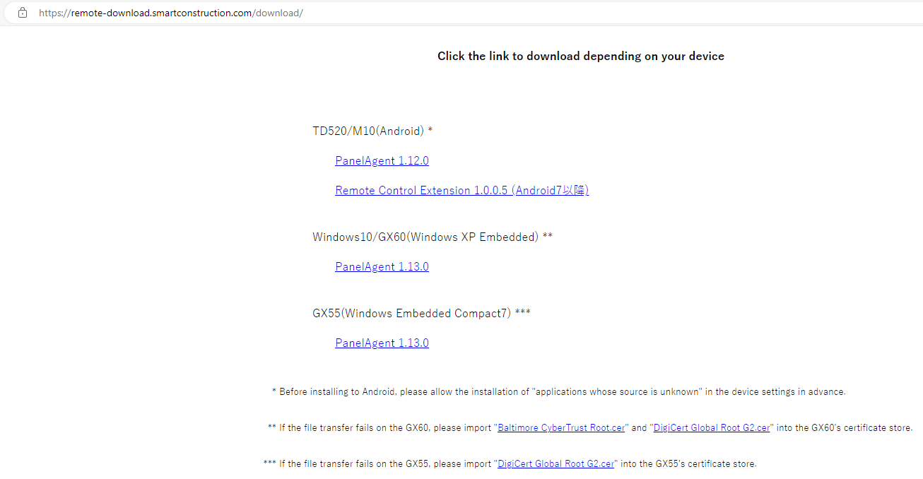
Step 1 Panel Agents and Digital Certificates
Download appropriate Panel Agent and Digital Certificate from Komatsu download site onto USB:
https://remote-download.smartconstruction.com/download
Download site (smartconstruction.com)

Slide 3
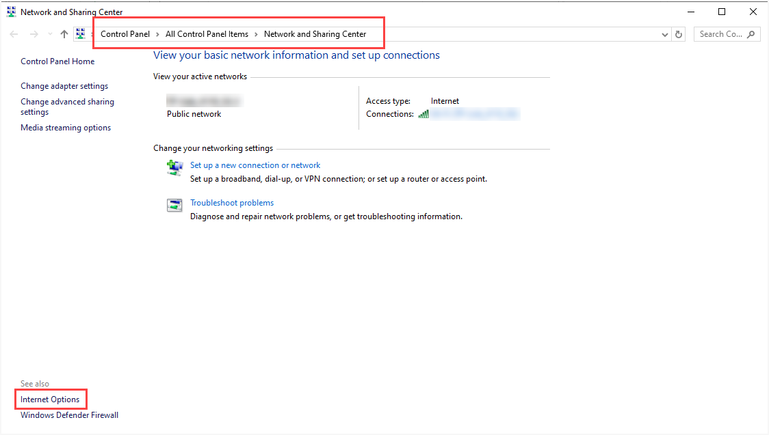
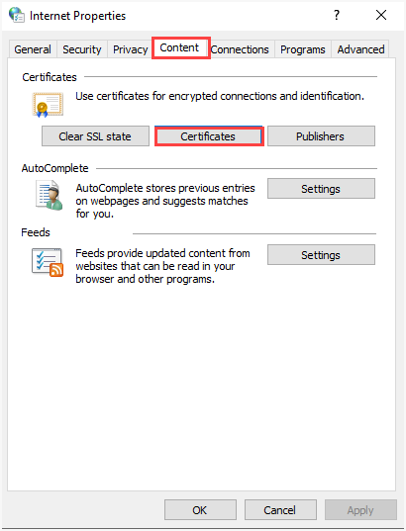
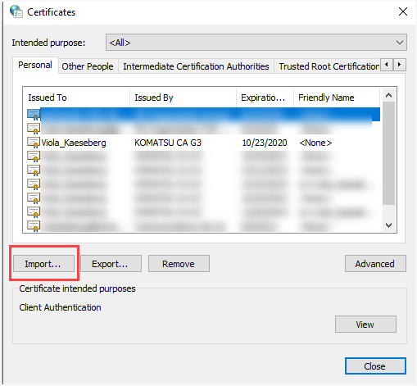

Step 2 Installation of Digital Certificate
Connect USB to FC6400.
Go to Network and Sharing Center→Internet Options→Content→Certificates and confirm appropriate Digital Certificate was installed. If there is no certificate, click Import and follow prompts until it’s completed.
Once Digital certificate is installed; install “Panel Agent” from USB.

Slide 4
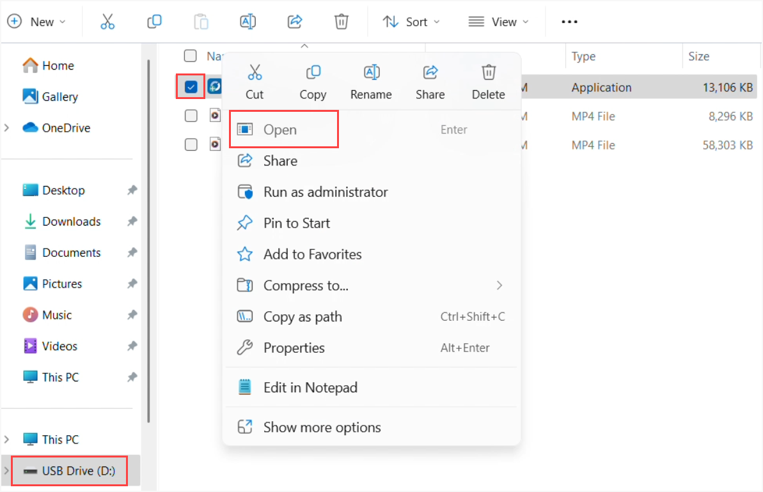
Step 3 Installation of Panel Agent
2
Connect USB to FC6400
Open USB drive (1), select Panel Agent (2), and select Open (3)
3
1

Slide 5
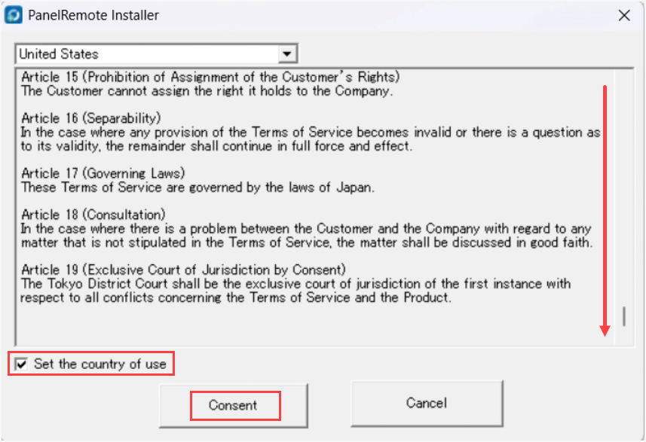
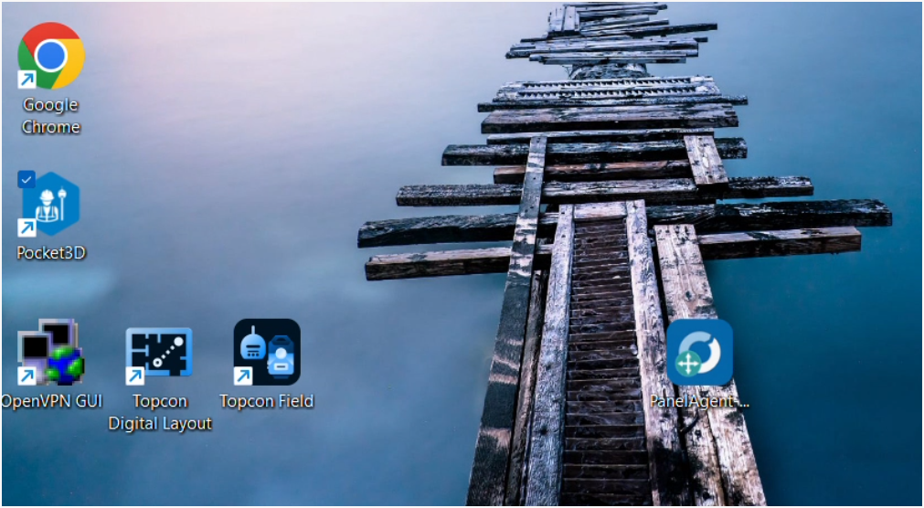
Step 4 Installation of Panel Agent
Panel Remote installer window will pop-up.
Read and scroll through entire terms of service.
To agree and continue, check the box and select Consent at the bottom of the screen.
Panel agent icon will appear on desktop.

Slide 6
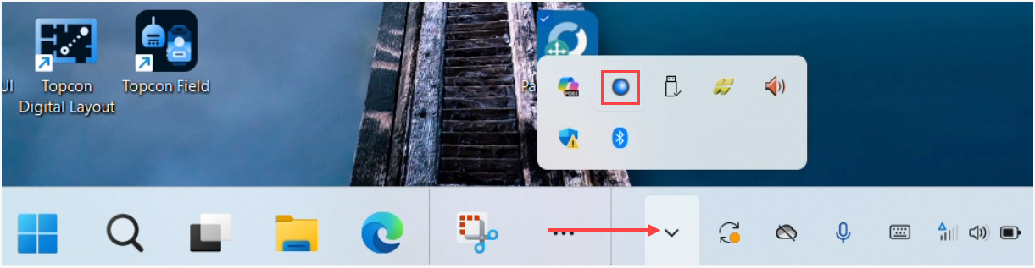
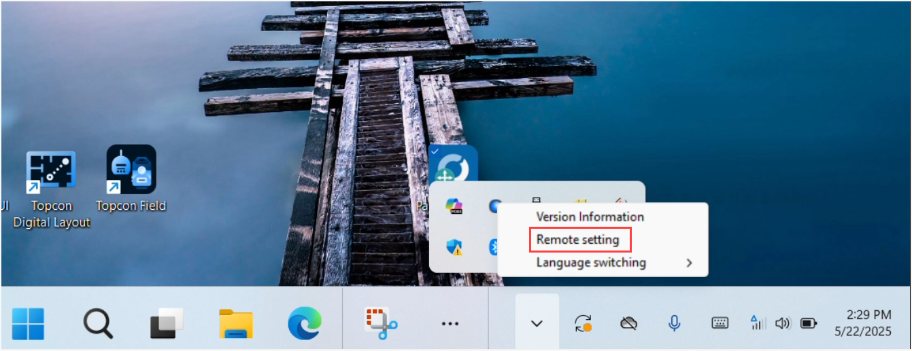
Step 5 Finding Device ID Number
Smart Construction Remote requires a MAC address/Device ID.
To find MAC address/Device ID, on the desktop ribbon, click on Blue Dot and select Remote Setting

Slide 7
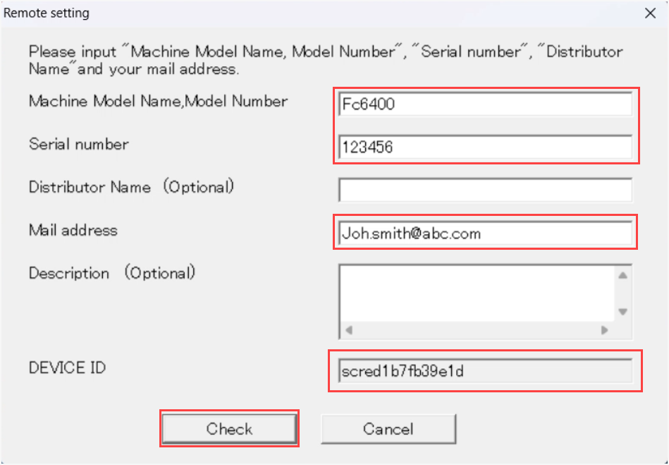
Step 6 Finding Device ID Number
Fill in necessary boxes and select Check
The system will send an email with Json file containing machine information and Device ID
Now the device is ready for registration in Smart Construction Remote

